Slide 1


FITFLEX: ECOSYSTEM OF FITNESS
Team:
Siddhant, CEO
Priyanka, MD
Lakhya, CTO
Susan, CFO

Slide 2






Meet Sam
General Manager
Fresher
Associate
Functional Manager
Associate Manager
2005
2010
2019
2015
2025

Slide 3



Slide 4
Do you know?
Absenteeism in Ireland costs Businesses approx.
€1.5 Billion a year
€818 per employee
One Day Corporate Wellness Program cost
€ 500 upwards
Does not guarantee behavioural change

Slide 5
Problem Statement
How to engage Sam with physical activities that improves his health and also contribute towards his organization’s success?
Expected Solution
To facilitate Healthy living with motivation driven by Community Effect, Gamification & Personal Analytics

Slide 6

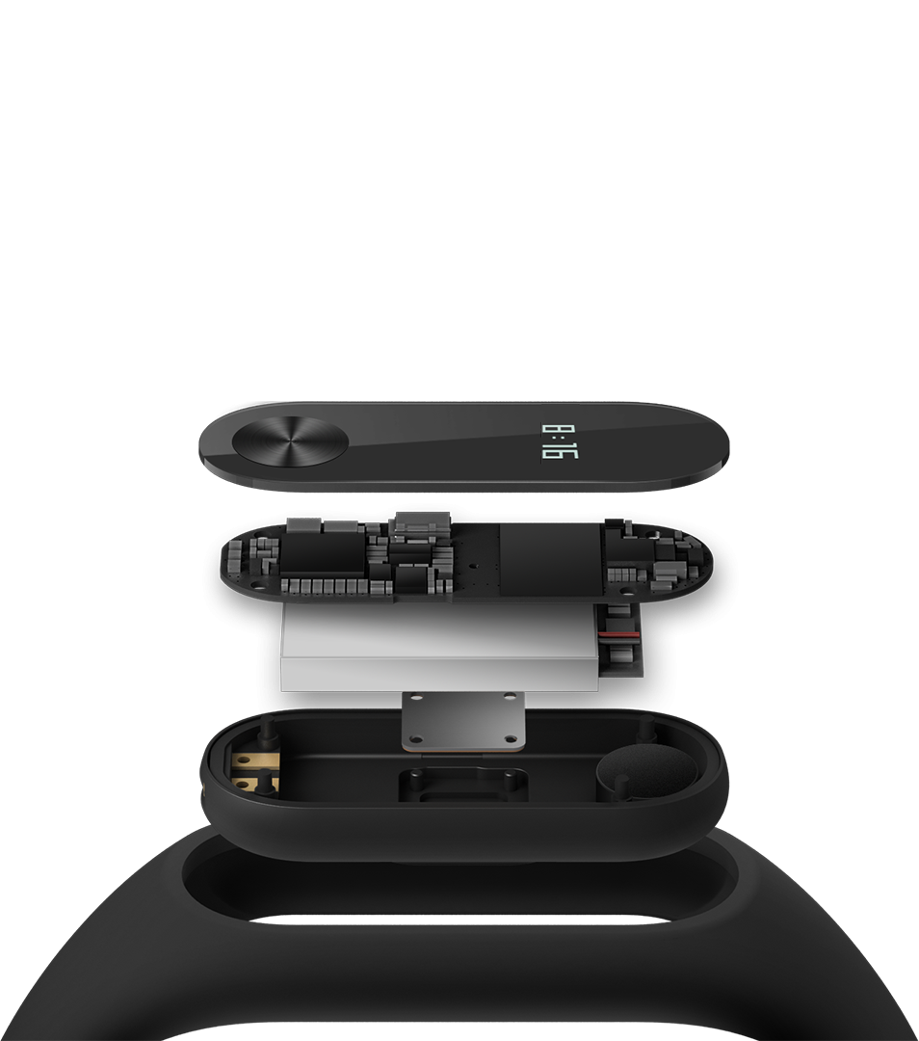
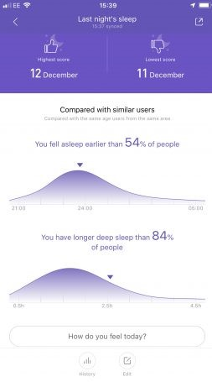

Our Offering
‘An Entire Ecosystem’

Slide 7

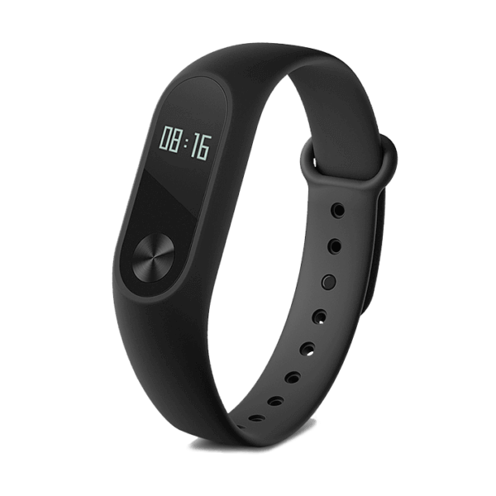



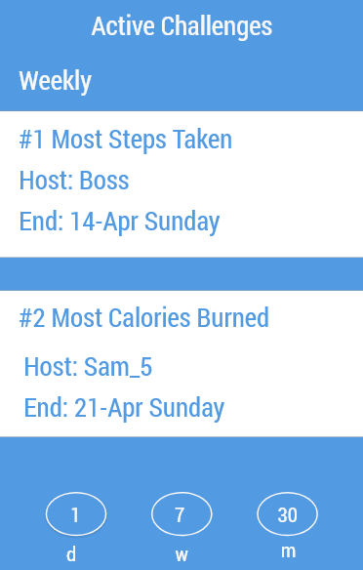
The Ecosystem In A Nutshell

Slide 8
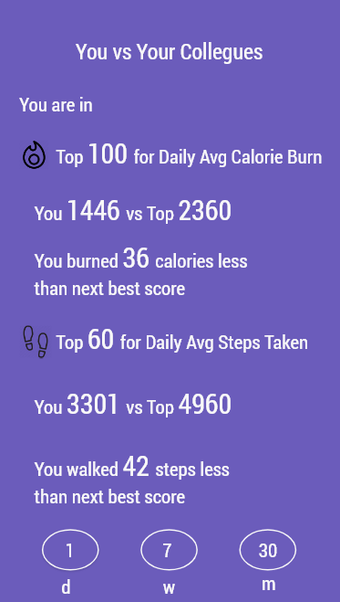
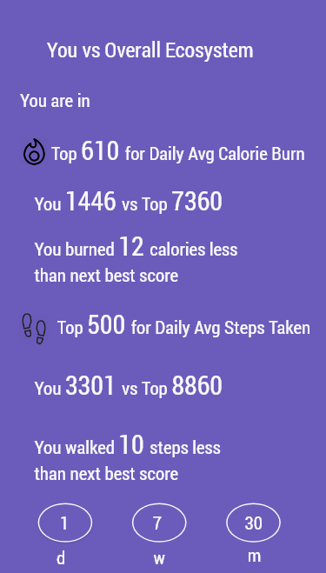


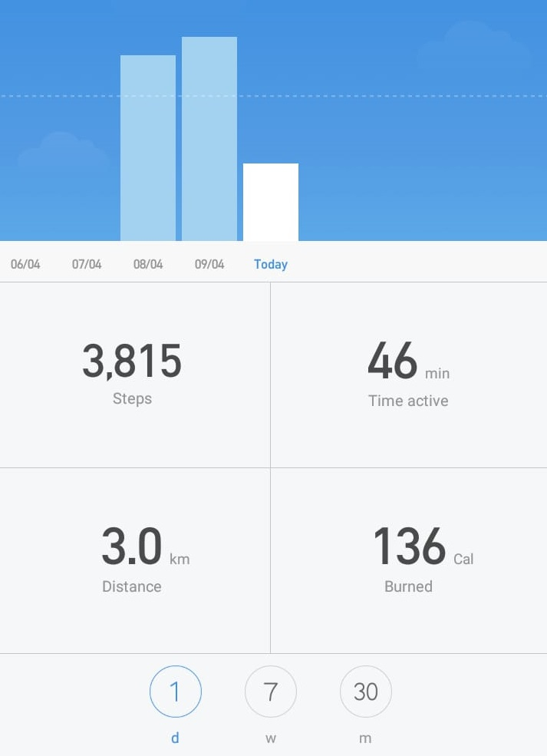



Slide 9
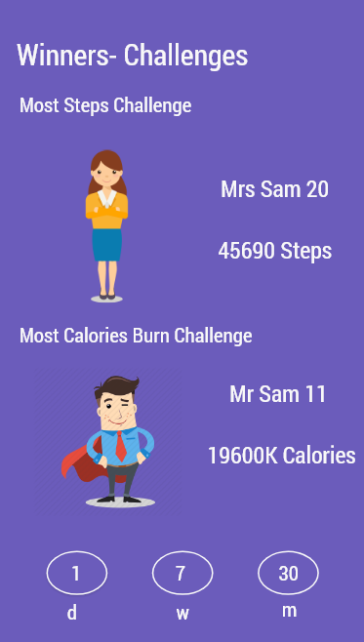
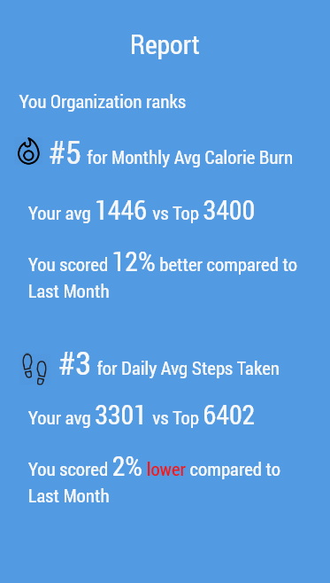

Slide 10

Health Risk Lowered from Regular Exercise
Type 2 Diabetes
Heart Disease/Stroke
50 %
35 %
Dementia
Depression
30 %
30 %
nhs.uk/live-well/exercise/exercise-health-benefits/

Slide 11




Target Markets
Why Them?
#WorkHappy Index
Under section 8
Safety Health and Welfare at Work Act 2005
‘Employers have a duty to ensure employee’s safety, health and welfare at work in order to prevent injuries and ill-health’
Reduce Sick Days
Increase Productivity

Slide 12



Subscription:
Monthly
(per Employee)
Our Revenue Model
FIRST MONTH | € 40
MONTHS AFTER | € 20
Yearly
€ 240
(per Employee)

Slide 13
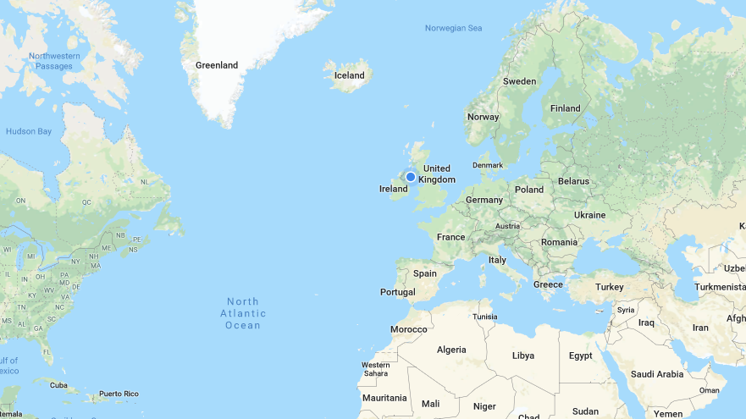


Slide 14

Stop Being Sam

